Slide 1
Managing Asynchronicity with RQ and JSCheck

Slide 2
Synchronous functions
Do not return until the work is complete or failed.

Slide 3
The Problems With Threads
Races
Deadlocks
Reliability
Performance

Slide 4
Threading
Pro
Con
No rethinking is necessary.
Blocking programs are ok.
Execution continues as long as any thread is not blocked.
Stack memory per thread.
If two threads use the same memory, a race may occur.

Slide 5
Two threads
my_array[my_array.length] = 'a';
my_array[my_array.length] = 'b';
['a', 'b']
['b', 'a']

Slide 6
Two threads
my_array[my_array.length] = 'a';
my_array[my_array.length] = 'b';
['a', 'b']
['b', 'a']
['a']
['b']

Slide 7
my_array[my_array.length] = 'a';
length_a = my_array.length;
my_array[length_a] = 'a';
if (length_a >= my_array.length) {
my_array.length = length_a + 1;
}

Slide 8
my_array[my_array.length] = 'a'; my_array[my_array.length] = 'b';
length_a = my_array.length;
my_array[length_a] = 'a';
if (length_a >= my_array.length) {
my_array.length = length_a + 1;
}
length_b = my_array.length;
my_array[length_b] = 'b';
if (length_b >= my_array.length) {
my_array.length = length_b + 1;
}

Slide 9
my_array[my_array.length] = 'a'; my_array[my_array.length] = 'b';
length_a = my_array.length;
length_b = my_array.length;
my_array[length_a] = 'a';
if (length_a >= my_array.length) {
my_array[length_b] = 'b';
my_array.length = length_a + 1;
}
if (length_b >= my_array.length) {
my_array.length = length_b + 1;
}

Slide 10
It is impossible to have application integrity when subject to race conditions.

Slide 11
Mutual Exclusion
semaphore
monitor
rendezvous
synchronization
This used to be operating system stuff.
It has leaked into applications because of networking and the multi-core problem.

Slide 12
Mutual Exclusion
Only one thread can be executing on a critical section at a time.
All other threads wanting to execute the critical section are blocked.
If threads don’t interact, then the program runs at full speed.
If they do interact, then races will occur unless mutual exclusion is employed.

Slide 13
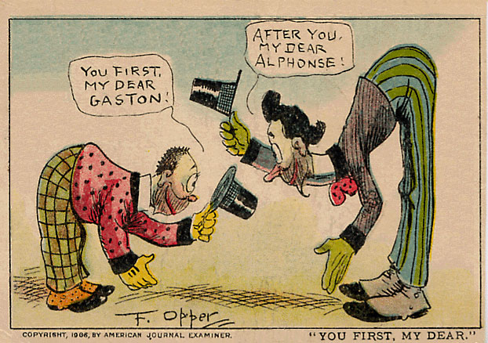
Deadlock

Slide 14
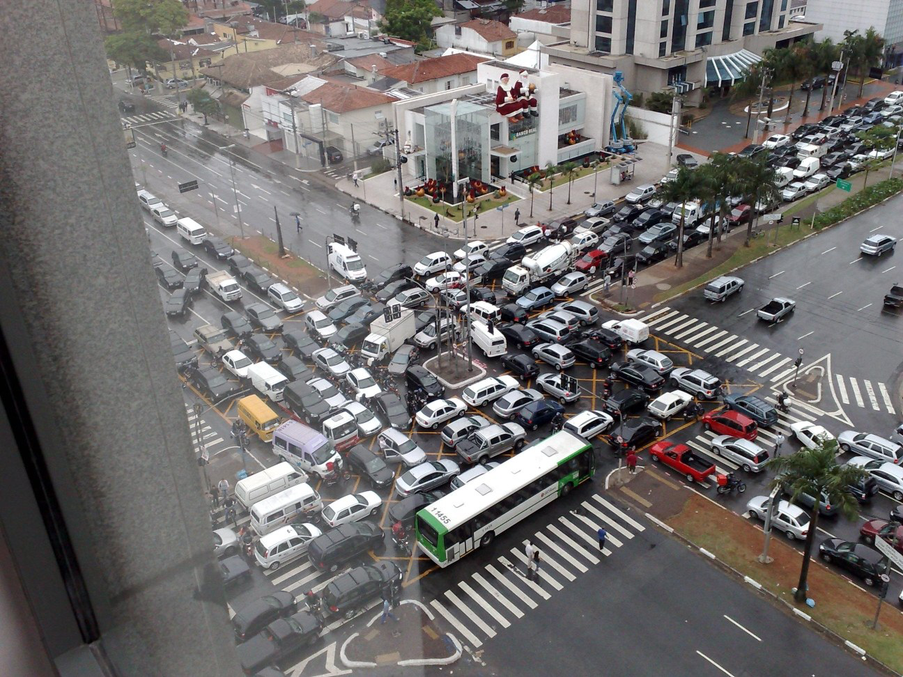
Deadlock

Slide 15
Asynchronous functions
Return immediately. Success or failure will be determined somehow in the future.

Slide 16
Event Loop
Pro
Con
Completely free of races and deadlocks.
Only one stack.
Very low overhead.
Resilient. If a turn fails, the program can still go on.
Programs must never block.
Turns must finish quickly.
Programs are inside out! Waa!

Slide 17
The Law of Turns
Never block.
Never wait.
Finish fast.

Slide 18
Event driven systems
Turn based. No pre-emption.
Associate events with actions.
Easy (beginners can do it).
User interfaces.

Slide 19
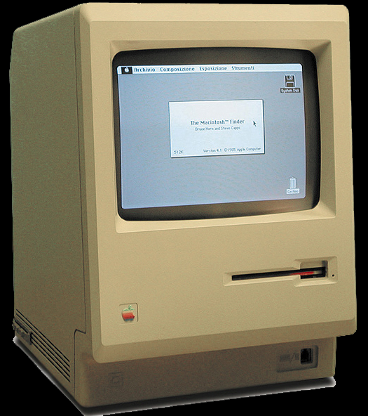

Slide 20
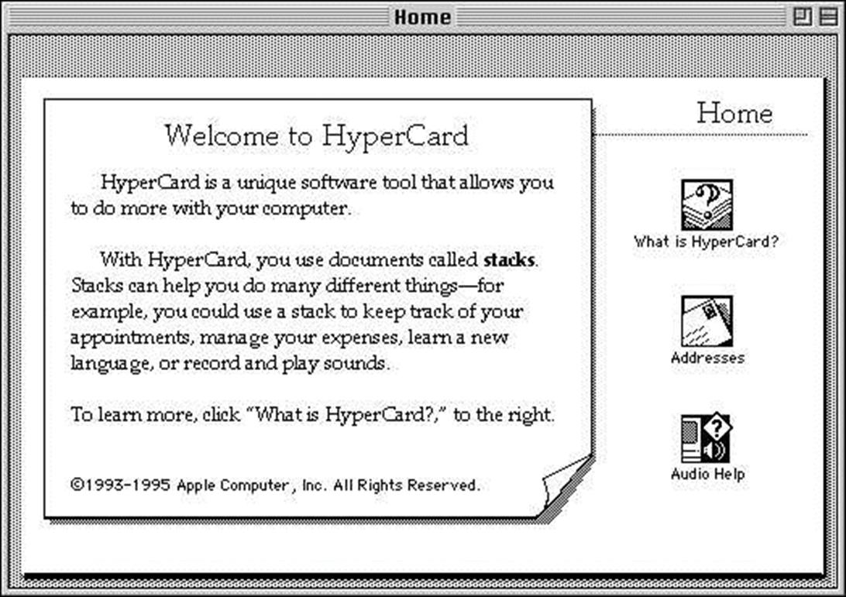
Notes:
Multi-plane b/w bitmap editor with a scripting language.
Non-programmers were amazingly productive with it.

Slide 21
JavaScript is moving to the server.
What servers do is quite different from what browsers do.

Slide 22
node.js
node.js implements a web server in a JavaScript event loop.
It is a high-performance event pump.
fs.readFile(filename, encoding, function (err, data) {...})
Everything is (or can be) non-blocking.
Except:
some synchronous functions
require

Slide 23
Servers
Message driven, message queue
Actor-like
Simple events don’t fit:
Sequential
A sequence of requests, each dependent on the result of the previous.
Naïve approach: deeply nested callbacks
Parallel
Do a bunch of independent things
Naïve approach: wastes time, increases latency
Limited time, cancellation

Slide 24
Functional Programming to the Rescue
Futures
Dataflow and LISP
Promise
Monads
Arrows
RX
FRP: Flapjax, bacon.js, elm.

Slide 25
RQ
A JavaScript library for managing asynchronicity in server applications.

Slide 26
Four or five methods
RQ.sequence(requestors)
RQ.parallel(requestors)
RQ.parallel(requestors, optionals)
RQ.race(requestors)
RQ.fallback(requestors)

Slide 27
RQ.sequence
Takes an array of requestor functions, calls them one at a time, passing the result of the previous requestor to the next requestor.
getNav = RQ.sequence([
read_file(filename),
getPreference,
getCustomNav
]);

Slide 28
RQ.parallel
Takes an array of requestor functions, calls them all at once, and gives an array of results.
getStuff = RQ.parallel([
getNav,
getAds,
getMessageOfTheDay
]);

Slide 29
RQ.parallel
Also takes an optional array of optional requestors. Their results will be included if they can be obtained before the required requestors finish.
getStuff = RQ.parallel([
getNav,
getAds,
getMessageOfTheDay
], [
getHoroscope,
getGossip
]);

Slide 30
RQ.race
Takes an array of requestors, calls them all at once, and gives the result of the first success.
getAds = RQ.race([
getAd(adnet.klikHaus),
getAd(adnet.inUFace),
getAd(adnet.trackPipe)
]);

Slide 31
RQ.fallback
Takes an array of requestors, and gives the result of the first success.
getWeather = RQ.fallback([
fetch("weather", localCache),
fetch("weather", localDB),
fetch("weather", remoteDB)
]);

Slide 32
RQ
All at once
One at a time
All
parallel
sequence
One
race
fallback

Slide 33
RQ.parallel([
RQ.sequence([
widget('Seq A1'),
widget('Seq A2'),
widget('Seq A3')
]),
RQ.sequence([
widget('Seq B1'),
widget('Seq B2'),
widget('Seq B3')
]),
widget('C'),
RQ.race([
widget('Race D1'),
widget('Race D2'),
widget('Race D3')
]),
RQ.fallback([
widget('Fall E1'),
widget('Fall E2'),
widget('Fall E3')
])
], [
RQ.sequence([
widget('Opt Seq O1'),
widget('Opt Seq O2'),
widget('Opt Seq O3')
]),
RQ.sequence([
widget('Opt Seq P1'),
widget('Opt Seq P2'),
widget('Opt Seq P3')
]),
widget('Opt Q'),
RQ.race([
widget('Opt Race R1'),
widget('Opt Race R2'),
widget('Opt Race R3')
]),
RQ.fallback([
widget('Opt Fall S1'),
widget('Opt Fall S2'),
widget('Opt Fall S3')
])
])(show);

Slide 34
RQ.sequence([
widget('Seq S1'),
RQ.parallel([
widget('Par P1'),
widget('Par P2'),
widget('Par P3'),
]),
widget('Seq S3')
])

Slide 35
RQ requestories with timeouts
RQ.sequence(requestors, milliseconds)
RQ.parallel(requestors, milliseconds)
RQ.parallel(requestors, optionals, milliseconds, tilliseconds)
RQ.race(requestors, milliseconds)
RQ.fallback(requestors, milliseconds)

Slide 36
Cancellation
Any requestor can optionally return a quash function.
A quash function, when called, will attempt to cancel a request.
There is no guarantee that the cancellation will happen before the request completes.
Cancellation is intended to stop unnecessary work. It does not undo.

Slide 37
RQ
requestor
A function that can execute a request
requestion (requestor continuation)
A continuation function that will be passed to a requestor
requestory (requestor factory)
A function that takes arguments and returns a requestor function.
quash
A function returned by a requestor that may be used to cancel a request.

Slide 38
requestor continuation
function requestory(arguments…) →
function requestor(
function requestion(success, failure),
value
) → function quash(reason)

Slide 39
requestor
function requestory(arguments…) →
function requestor(
function requestion(success, failure),
value
) → function quash(reason)

Slide 40
quash
function requestory(arguments…) →
function requestor(
function requestion(success, failure),
value
) → function quash(reason)

Slide 41
requestor factory
function requestory(arguments…) →
function requestor(
function requestion(success, failure),
value
) → function quash(reason)

Slide 42
Identity Requestor
function identity_requestor(
requestion,
value
) {
return requestion(value);
}

Slide 43
Fullname Requestor
function fullname_requestor(
requestion,
value
) {
return requestion(
value.firstname
+ ' ' + value.lastname
);
}

Slide 44
Wrap Requestory
function requestorize(func) {
return function requestor(requestion, value) {
return requestion(func(value));
};
}
var fullname_requestor = requestorize(
function (value) {
return value.firstname + ' '
+ value.lastname;
}
);

Slide 45
Delay Requestor
function delay(milliseconds) {
function delay_requestor(requestion, value) {
var timeout_id = setTimeout(function () {
return requestion(value);
}, 1000);
return function quash(reason) {
return clearTimeout(timeout_id);
};
};

Slide 46
Delay Requestory
function delay(milliseconds) {
return function requestor(requestion, value) {
var timeout_id = setTimeout(function () {
requestion(value);
}, milliseconds);
return function quash(reason) {
return clearTimeout(timeout_id);
};
};
}

Slide 47
Read File Requestory
function read_file(filename, encoding) {
return function requestor(requestion, value) {
return fs.readFile(
filename,
encoding || 'utf-8', function (err, data) {
return requestion(data, err);
}
);
};
}

Slide 48
function widget(name) {
return function requestor(requestion, value) {
var result = value ? value + '>' + name : name,
demo = document.getElementById("demo"),
fieldset = document.createElement("fieldset"),
legend = document.createElement("legend"),
success = document.createElement("input"),
failure = document.createElement("input");
fieldset.appendChild(legend);
fieldset.appendChild(success);
fieldset.appendChild(failure);
legend.appendChild(document.createTextNode(name));
success.type = "button";
success.value = "success";
success.addEventListener("click", function () {
fieldset.style.backgroundColor = "lightgreen";
return requestion(result);
}, false);
failure.type = "button";
failure.value = "failure";
failure.addEventListener("click", function () {
fieldset.style.backgroundColor = "pink";
return requestion(undefined, result);
}, false);
demo.appendChild(fieldset);
return function quash() {
fieldset.style.backgroundColor = "silver";
};
};
}

Slide 49
function widget(name) {
return function requestor(requestion, value) {
var result = value ? value + '>' + name : name,
demo = document.getElementById("demo"),
fieldset = document.createElement("fieldset"),
legend = document.createElement("legend"),
success = document.createElement("input"),
failure = document.createElement("input");
fieldset.appendChild(legend);
fieldset.appendChild(success);
fieldset.appendChild(failure);
legend.appendChild(document.createTextNode(name));
success.type = "button";
success.value = "success";
success.addEventListener("click", function () {
fieldset.style.backgroundColor = "lightgreen";
return requestion(result);
}, false);
failure.type = "button";
failure.value = "failure";
failure.addEventListener("click", function () {
fieldset.style.backgroundColor = "pink";
return requestion(undefined, result);
}, false);
demo.appendChild(fieldset);
return function quash() {
fieldset.style.backgroundColor = "silver";
};
};
}
success.addEventListener("click", function () {
fieldset.style.backgroundColor =
"lightgreen";
return requestion(result);
}, false);

Slide 50
function widget(name) {
return function requestor(requestion, value) {
var result = value ? value + '>' + name : name,
demo = document.getElementById("demo"),
fieldset = document.createElement("fieldset"),
legend = document.createElement("legend"),
success = document.createElement("input"),
failure = document.createElement("input");
fieldset.appendChild(legend);
fieldset.appendChild(success);
fieldset.appendChild(failure);
legend.appendChild(document.createTextNode(name));
success.type = "button";
success.value = "success";
success.addEventListener("click", function () {
fieldset.style.backgroundColor = "lightgreen";
return requestion(result);
}, false);
failure.type = "button";
failure.value = "failure";
failure.addEventListener("click", function () {
fieldset.style.backgroundColor = "pink";
return requestion(undefined, result);
}, false);
demo.appendChild(fieldset);
return function quash() {
fieldset.style.backgroundColor = "silver";
};
};
}
failure.addEventListener("click", function () {
fieldset.style.backgroundColor = "pink";
return requestion(undefined, result);
}, false);

Slide 51
function widget(name) {
return function requestor(requestion, value) {
var result = value ? value + '>' + name : name,
demo = document.getElementById("demo"),
fieldset = document.createElement("fieldset"),
legend = document.createElement("legend"),
success = document.createElement("input"),
failure = document.createElement("input");
fieldset.appendChild(legend);
fieldset.appendChild(success);
fieldset.appendChild(failure);
legend.appendChild(document.createTextNode(name));
success.type = "button";
success.value = "success";
success.addEventListener("click", function () {
fieldset.style.backgroundColor = "lightgreen";
return requestion(result);
}, false);
failure.type = "button";
failure.value = "failure";
failure.addEventListener("click", function () {
fieldset.style.backgroundColor = "pink";
return requestion(undefined, result);
}, false);
demo.appendChild(fieldset);
return function quash() {
fieldset.style.backgroundColor = "silver";
};
};
}
return function quash() {
fieldset.style.backgroundColor = "silver";
};

Slide 52
Testing
assertEquals(message, expected, actual)
does not work

Slide 53
QuickCheck
Koen Claessen
John Hughes
Chalmers University

Slide 54
JSCheck
Case generation
Testing over turns
JSC.claim(name, predicate, signature)
JSC.check(milliseconds)
JSC.on_report(callback)
JSC.on_error(callback)

Slide 55
JSC.claim(name, predicate, signature)
name is a string
function predicate(verdict, et al…)
signature is an array of specifications, one per et al…
JSC.claim(
"Compare the old code with the new code", function predicate(verdict, a) { verdict(oldCode(a) === newCode(a)); }, [JSC.integer()] );

Slide 56
Specifiers
JSC.any()
JSC.array()
JSC.boolean() JSC.character()
JSC.falsy()
JSC.integer()
JSC.literal()
JSC.number()
JSC.object()
JSC.one_of()
JSC.sequence()
JSC.string()

Slide 57
JSC.string(
3, JSC.character('0', '9'),
1, '-',
2, JSC.character('0', '9'),
1, '-',
4, JSC.character('0', '9')
)
"094-55-0695"
"571-63-9387"
"130-08-5751"
"296-55-3384"
"976-55-3359"

Slide 58
JSC.array([
JSC.integer(),
JSC.number(100),
JSC.string(8, JSC.character('A', 'Z'))
])
[3, 21.228644298389554, "TJFJPLQA"]
[5, 57.05485427752137, "CWQDVXWY"]
[7, 91.98980208020657, "QVMGNVXK"]
[11, 87.07735128700733, "GXBSVLKJ"]

Slide 59
JSC.object({
left: JSC.integer(640),
top: JSC.integer(480),
color: JSC.one_of([
"black", "white", "red",
"blue", "green", "gray"
])
})
{"left":104, "top":139, "color":"gray"}
{"left":62, "top":96, "color":"white"}
{"left":501, "top":164, "color":"red"}
{"left":584, "top":85, "color":"white"}

Slide 60
JSC.object(
JSC.array(
JSC.integer(3, 8),
JSC.string(4, JSC.character('a', 'z'))
),
JSC.boolean()
)
{"jodo":true, "zhzm":false, "rcqz":true}
{"odcr":true, "azax":true, "bnfx":true,
"hmmc":false}
{"wjew":true, "kgqj":true, "abid":true,
"cjva":false, "qsgj":true, "wtsu":true}
{"qtbo":false, "vqzc":false, "zpij":true,
"ogss":false, "lxnp":false, "psso":true,
"irha":true, "ghnj":true}

Slide 61
verdict
When check calls a predicate, it passes in a verdict function.
Predicates deliver the result of each trial by calling the verdict function.
verdict is a continuation, allowing trials to extend over many turns.
Three outcomes:
pass fail lost

Slide 62
Closure and continuation.

Slide 63
https://github.com/douglascrockford/RQ https://github.com/douglascrockford/JSCheck

